Slide 1
UI Design
Start screen UI
Settings UI
Level settlement UI

Slide 2
Fill Moom Rise
Start
Setting
Quit

Slide 3
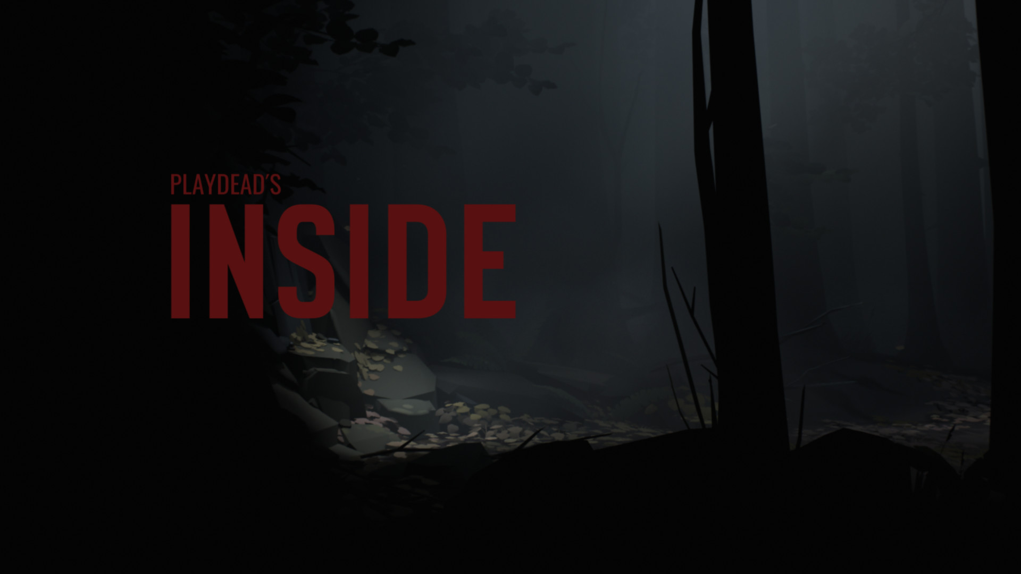
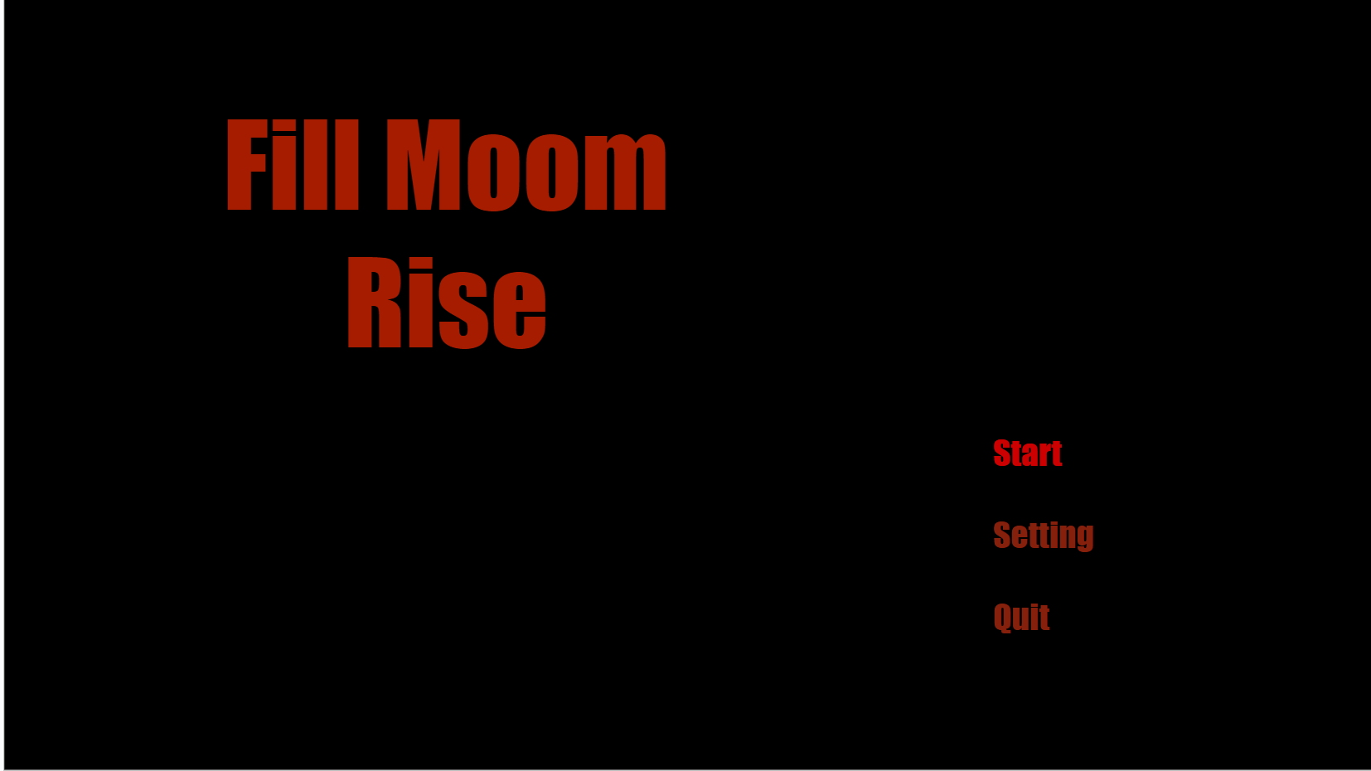
Font ：Impact
Start screen
The background can be the scene of the game，The font color could be darker.
If one of these options is selected, the text will become lighter

Slide 4
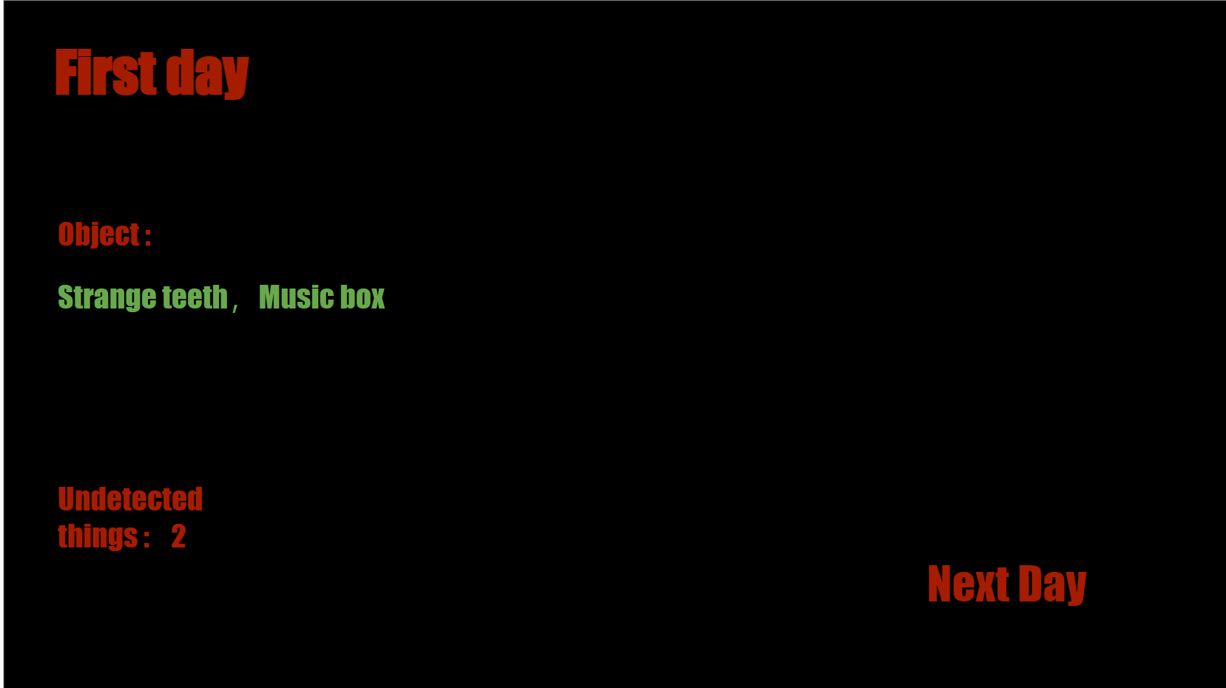
Level settlement UI
Overall layout: Shows the day, which items were collected, how many you didn't find, and the next day.

Slide 5
First day
Object :
Strange teeth，Music box
Undetected things : 2
Next Day

Slide 6
Settings
Back
Audio: - 9 +
Quit the game

Slide 7
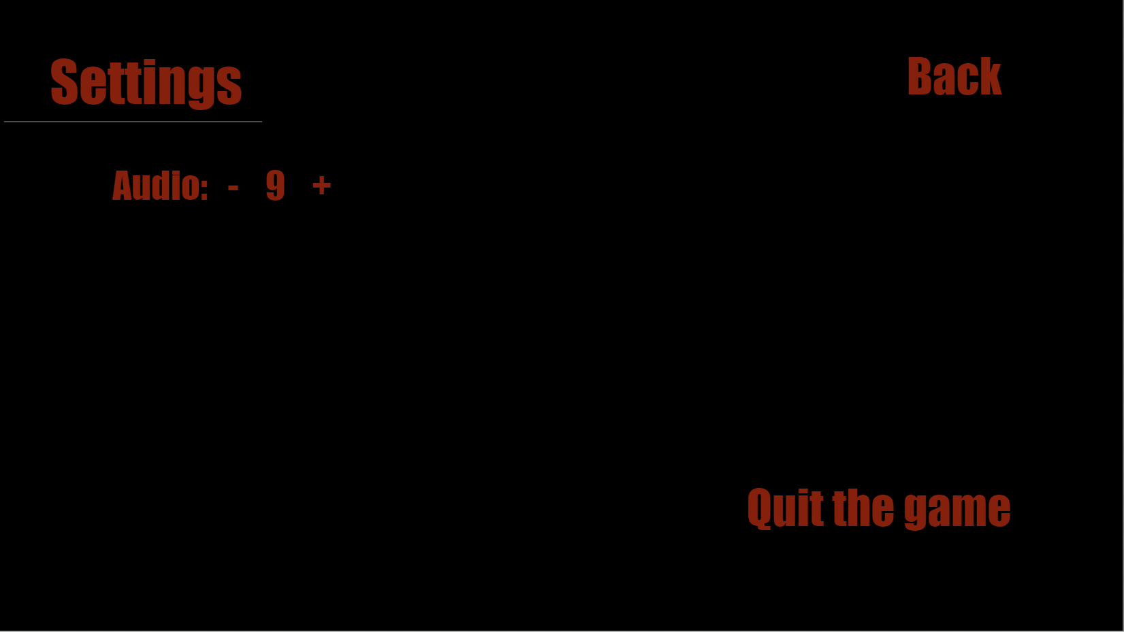
Settings UI
The player can set the Audio in the game and the Menu, and tap Back return to the previous page, in the game start screen, there is no "Quit game" option in the Settings, but the player can call this menu in the game by pressing esc, and can Quit the game.

